Slide 1

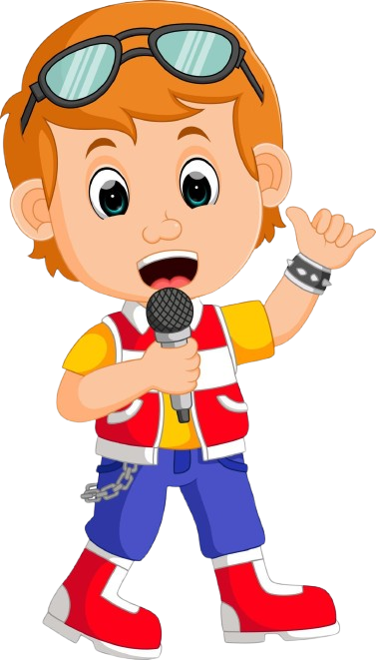
SAINIK PUBLIC SCHOOL
Date: 16/05/2025
SPELL BEE COMPETITION
(VI TO VIII)

Slide 2


Welcome to
Date: 16/05/2025
“Spell Bee” Competition

Slide 3
Round 1
Spell the word

Slide 4
Round 2
PICTURE RECOGNITION AND SPELLING

Slide 5
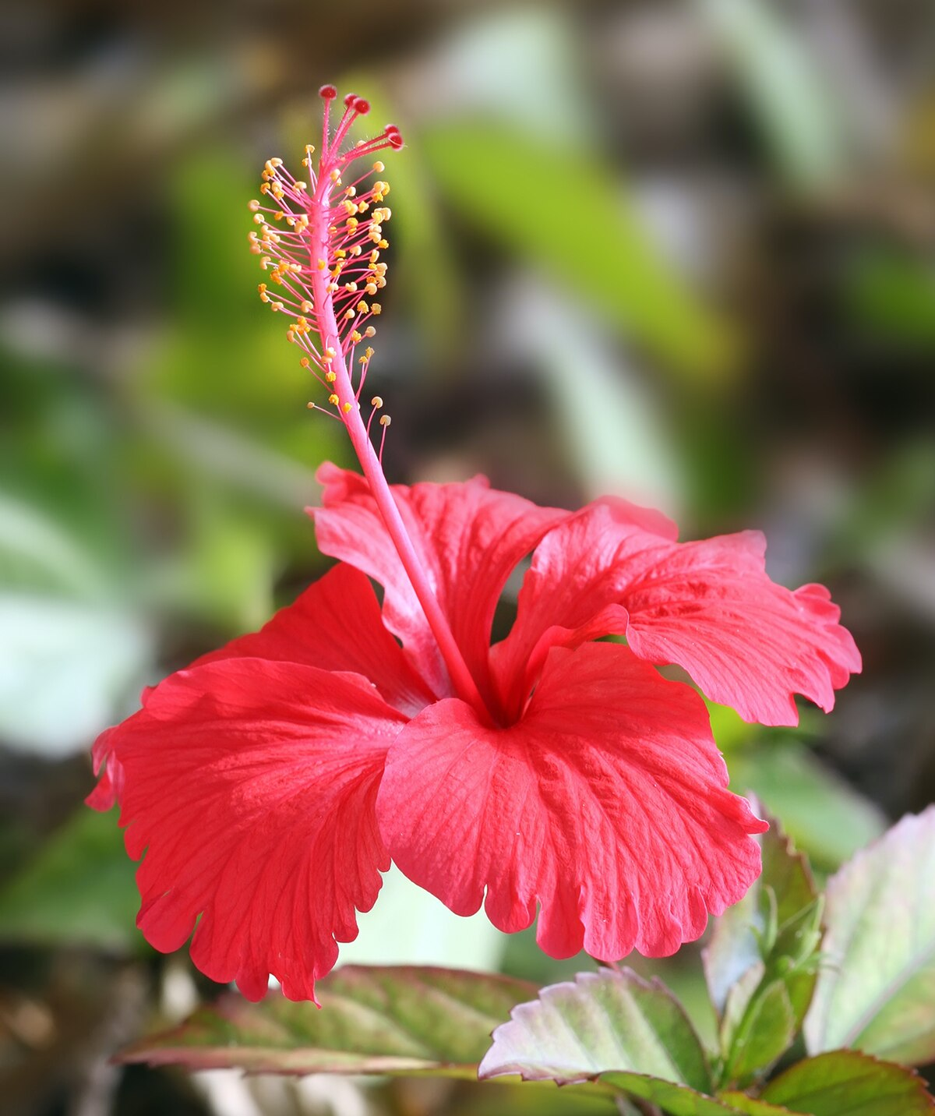

Slide 6


Slide 7
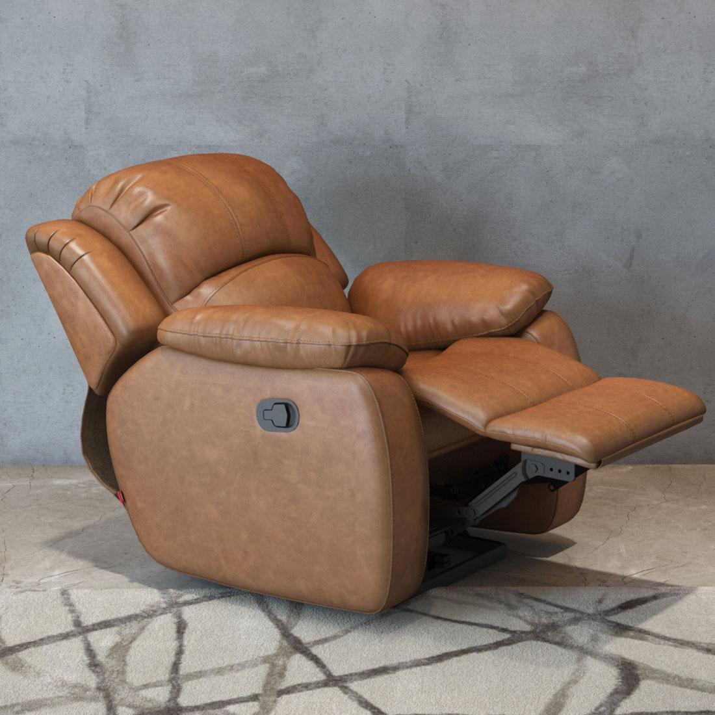

Slide 8


Slide 9
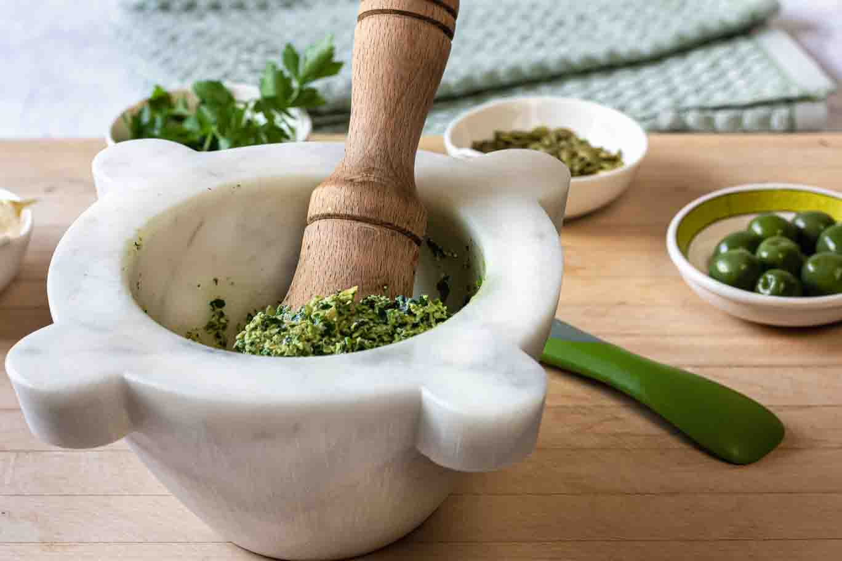

Slide 10
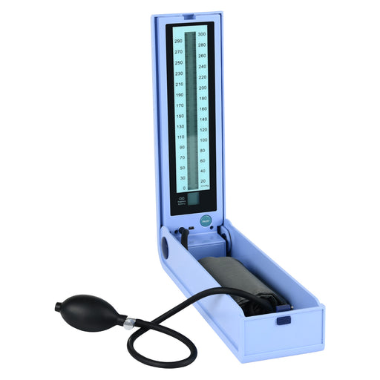

Slide 11
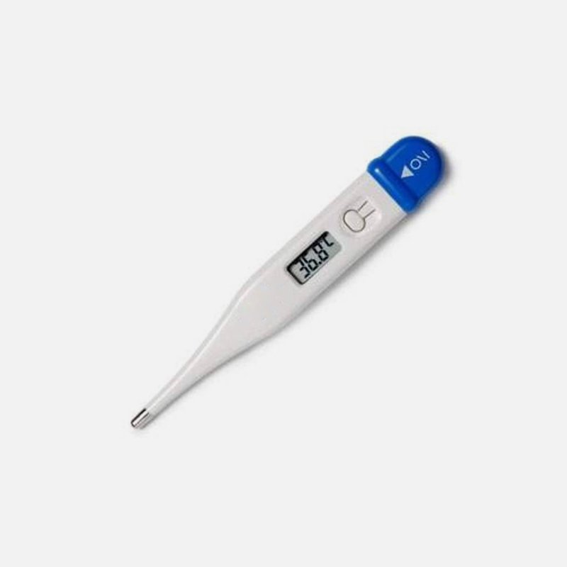

Slide 12
Round 3
CLUE BASED

Slide 13
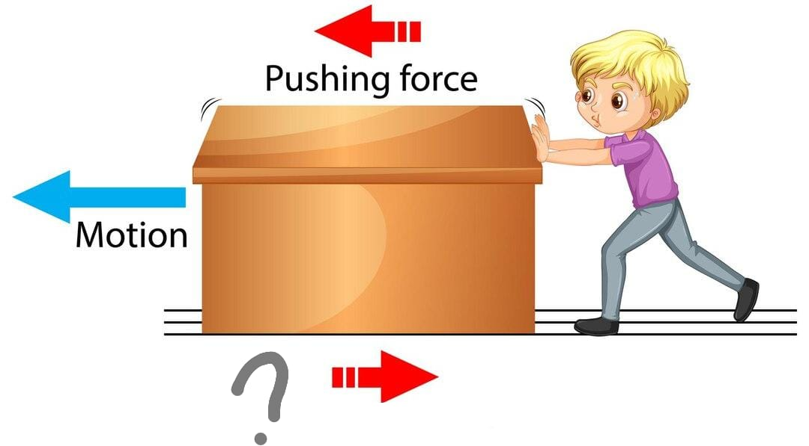
Clue: The resistance that one surface or object encounters when moving over another.

Slide 14
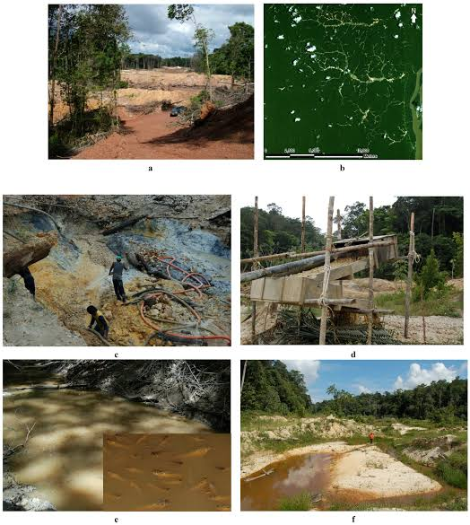
Clue: The wearing
away of
the land's uppermost
surface by wind,
water,
or other
natural agents.

Slide 15
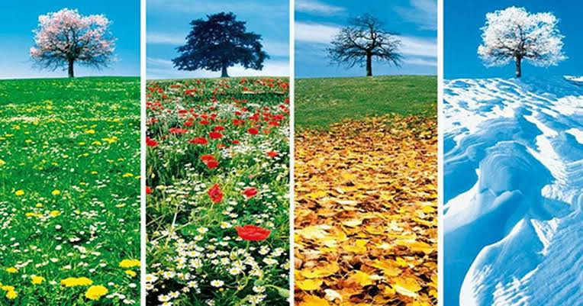
Clue: The average weather conditions of a place over a long period?

Slide 16
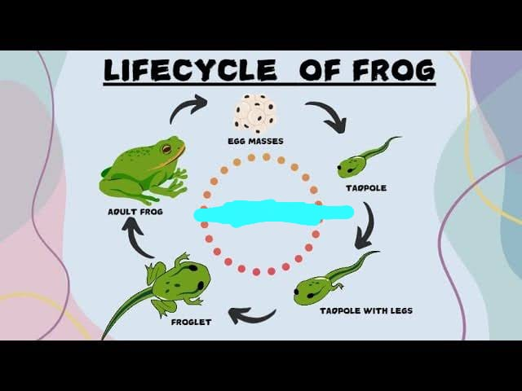
Name the process ?

Slide 17
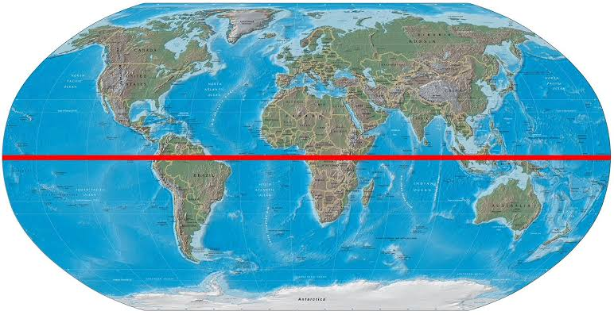
Clue: The imaginary line drawn on the Earth that divides it into the Northern Hemisphere and the Southern Hemisphere.

Slide 18
Round 4
UNSCRAMBLE WORD

Slide 19
Unscramble: T A A P D O I N T A Clue: A characteristic that enhances an organism's survival and reproduction in its environment.

Slide 20
Unscramble: Y T S E M S E C O Clue: A biological community of interacting organisms and their physical environment

Slide 21
Unscramble: OTINNA Clue: A large group of people who share a common territory and are subject to a single system of rule.

Slide 22
Thank you!

